Slide 1
CQARank:Jointly Model Topics and Expertise in Community Question Answering
Liu Yang, Minghui Qiu, Swapna Gottipati, Feida Zhu, Jing Jiang, Huiping Sun, Zhong Chen
Peking University
Singapore Management University
Notes:
Hi all, thanks for your time, and hope you can enjoy my talk. I’m Liu Yang who comes from Peking University and this work was done during my visit to Singapore Management
University. This is a collaborative work with my supervisors and colleagues.
(Each presentation of full paper is allotted 25 minutes in total. The presenters are advised to prepare a 20-minutes presentation to leave sufficient time for Q&A and speaker change.)
1 when you present the method, focus more on the intuition rather than the technical details. E.g. For the CQARank algorithm, it's important to explain the key ideas to the audience, and this explanation doesn't need to be in any mathematical form. Remember that it's hard for the audience to digest formulas during a talk.
2 Add more examples and explanations. Cut words and sentences

Slide 2
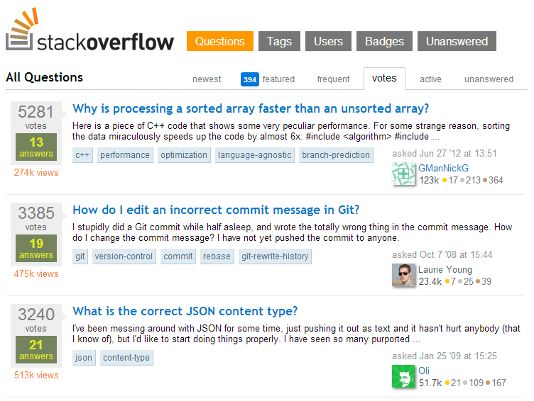
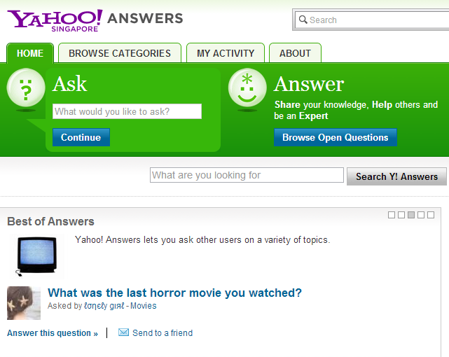


Community Question Answering
Open platforms for sharing expertise
Large repositories of valuable knowledge
CIKM2013
Notes:
The recent boom of Web 2.0 has seen the emergence of many knowledge sharing community services such as Stack Overflow , Yahoo! Answers, Quora and Baidu Zhidao. The huge success of Community Question Answering(CQA) in recent years provides open platforms for online community to share expertise and large repositories of valuable knowledge.

Slide 3
Existing CQA Mechanism Challenges
Poor expertise matching
Low-quality answers
Under-utilized archived questions
Fundamental question: how to model topics and expertise in CQA sites
CIKM2013
Notes:
However, existing question answering mechanism in CQA sites still face major challenges:
(1) Poor expertise matching: A new question, in many cases, may not find its way to the right people with the best-matching interest and ability to answer it. This can result in suboptimal answers and prolonged latency.
(2) Low-quality answers: CQA sites may contain low-quality answers such as spams. These answers often receive low ratings or voting from community members.
(3) Under-utilized archived questions: Many questions from different users are in fact similar. Before posting a new question, a user may benefit from browsing related archived
questions and their answers first.
Essentially, a fundamental question underlying all these tasks is how to model topics and expertise in CQA sites.
That is the problem we want to study in our work

Slide 4
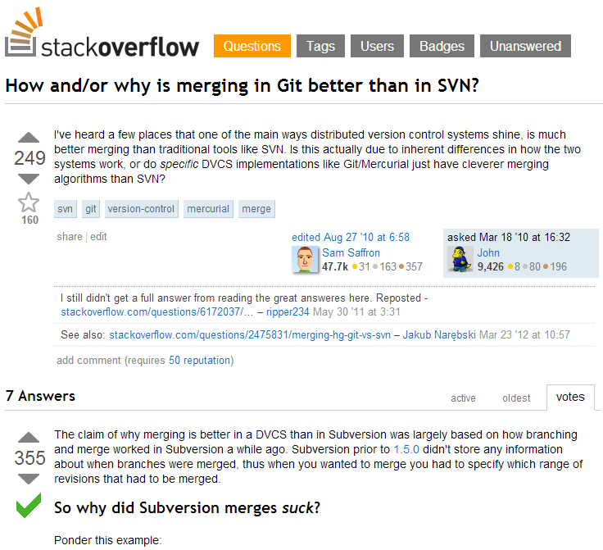
Motivation
A case study of Stack Overflow
Question
Tag
Vote
User
Answer
CIKM2013
Notes:
This is a snapshot of Stack Overflow which is the largest CQA focused on computer programming. The basic elements of a community question answering system are questions, answers and users. The asker could assign tags to the proposed question to label the topic information. Both questions and answers have vote scores given by users in CQA. Users can vote-up or vote-down Q&A posts. The value of vote score equals the difference between times of vote-up and vote-down.

Slide 5
Motivation
Propose a principle approach to jointly model topics and expertise in CQA
No one is expert in all topical interests
Each new question should be routed to answerers interested in related topics with the right level of expertise
Achieve better understanding of both user topical interest and expertise by leveraging tagging and voting information
Tags are important user-generated category information of Q&A posts
Votes indicate a CQA community’s long term review result for a given user’s expertise under a specific topic
CIKM2013
Notes:
In our work, we propose a principle approach to jointly model topics and expertise in CQA. Traditionally, topics and expertise have been modelled separately.
Despite their success in each aspect, there is a strong need in real-life CQA services to integrate these two aspects together to enhance user experience.
For one hand, no one is expert in all topical interests, which means one’s expertise level should be evaluated with respect to the corresponding topics.
On the other hand, every new question falls into some particular topics, and they should be routed to answerers interested in those particular topics with the right level of expertise.
We take both user topical interest and expertise evaluation into our model, enabling our method to find experts with both similar topical preference and matching topical expertise.
Furthermore, we achieve better understanding of both user topical interest and expertise by leveraging tagging and voting information.
(I) Tagging information — Tags are important user-generated category information for many Q&A communities, e.g., technical forums, that achieves fine-grained and dynamic topic representation.
(II) Voting information — Votes indicate a CQA community’s long term review for a given user’s expertise level under a specific topic Users with high expertise tend to receive high votes for their Q&A posts. This motivates us to exploit the votes for a user given specific topics to model user topical expertise.

Slide 6

Roadmap
Motivation
Related Work
Our Method
Method Overview
Topic Expertise Model
CQARank
Experiments
Summery
CIKM2013

Slide 7
Related Work
Link Analysis
HITS (Jurczyk and Agichtein, CIKM07)
Expertise Rank and Z-score (Zhang et al., WWW07)
Find global experts without model of user interests
Latent Topical Analysis
UQA Model ( Guo et al. CIKM08)
Fail to capture to what extent these users’ expertise match the questions with similar topical interest
Topic Sensitive PageRank
TwitterRank (Weng et al. WSDM10)
Topic-sensitive probabilistic model for expert finding (Zhou et al. CIKM12)
CIKM2013
Notes:
The most related works are about expert finding in CQA. Current methods are based on link analysis and latent topic modelling techniques. Jurczyk and Agichtein applied HITS algorithm on the underlying graph of CQA for estimating user ranking scores. Zhang et. al. proposed expertise ranking and Z-score to measure the relative expertise of a user. Although link analysis technique helps find authoritative users, a given new question on some specific topics might not interest these global experts or match their expertise and skills.
To find topic-level experts, topic-model-based methods are proposed for user topical interests analysis. Guo et. al. proposed a generative model for questions and answers by exploring the category information to discover latent interests of users and recommend question answerers for new arrival questions. While latent topic analysis could find users interested in a given new question, these approaches fail to capture to what extent these users’ expertise and skills match the questions with similar topical interest.
Furthermore, some approaches try to combine topical models and link analysis for finding authoritative users. A typical work is TwitterRank, an extension
of PageRank algorithm to measure the influence of users in Twitter. For CQA domains, Zhou and his colleagues proposed Topic-Sensitive PageRank(TSPR) for expert finding.
Our study differs from these works in that we jointly model topics and expertise, taking in consideration both user topical interest and expertise evaluation into our probalistic model. We also better integrate data components of CQA such as tagging and voting information into our proposed method.

Slide 8
Roadmap
Motivation
Related Work
Our Method
Method Overview
Topic Expertise Model
CQARank
Experiments
Summery
CIKM2013

Slide 9
Method Overview
Concepts
Topical Interest
Topical Expertise
Q&A Graph
Our Approach
Topic Expertise Model
CQARank to combine learning results from TEM with link analysis of Q&A graph
CIKM2013
Notes:
Before I introduce our method, let me first talk about main concepts used in our model.
Topical Interest refers to user preference for specific topics in CQA. For example, some users prefer to post content related to “Java”, while others are more interested in “database”.
Topical Expertise refers to users’ skill and experience on specific topics in CQA. Different users have different topical expertise. Moreover, one user could have different expertise levels for different topics. For example, a user may be a expert for the “Java” topic but a beginner for "Matlab".
Q&A Graph refers to the network based on user posting behavior in CQA. Nodes denote users and a directed edge exists between two users if one of them has answered questions by the other, where the edge direction is from the asker to the answerer.
Our method include two steps:
The first step is to jointly model Q&A textual content with votes and tags using our probabilistic Topic Expertise Model
Then we apply our CQARank to combine learning results from TEM with link analysis of Q&A graph to discover user topical interests and expertise.

Slide 10
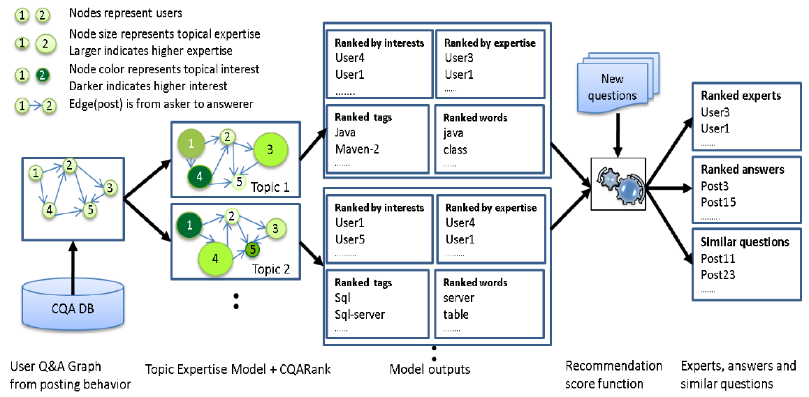
Method Overview
CQARank Recommendation Framework
CIKM2013
Notes:
This is the CQARank recommendation framework proposed in our paper. We first construct a Q&A graph from user posting behaviour in CQA corpus. We then jointly model Q&A textual content with votes and tags using our probabilistic Topic Expertise Model. Finally, we apply our CQARank to combine learning results from TEM with link analysis of Q&A graph to discover user topical interests and expertise. For each topic, different users exhibit different topical interests and expertise in Q&A graph, so we get user lists ranked by their interests and expertise. We also have top tags and words for each topic as model results. For new questions, using recommendation score functions, we process the model outputs along with the question to generate ranked experts, answers and similar questions.

Slide 11
Roadmap
Motivation
Related Work
Our Method
Method Overview
Topic Expertise Model
CQARank
Experiments
Summery
CIKM2013

Slide 12



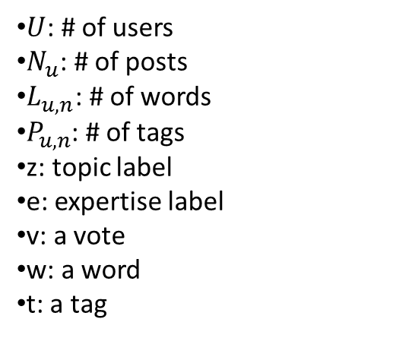















Topic Expertise Model
User topical expertise distribution
User specific topic distribution
$$β$$
$$φ_{k,u}$$
$$θ_{u}$$
$$α$$
K*U
U
$U$: # of users
$N_{u}$: # of posts
$L_{u,n}$: # of words
$P_{u,n}$: # of tags
z: topic label
e: expertise label
v: a vote
w: a word
t: a tag
e
z
v
w
t
$$L_{u,n}$$
$$P_{u,n}$$
$$N_{u}$$
$$U$$
Expertise specific vote distribution
Topic specific word and tag distribution
$$μ_{e}$$
$$Σ_{e}$$
$$φ_{k}$$
$$ψ_{k}$$
E
K
K
$$μ_{0}$$
$$k_{0}$$
$$α_{0}$$
$$β_{0}$$
$$γ$$
$$η$$
CIKM2013
Notes:
Now let’s look at our Topic Expertise Model
In a typical CQA system, each user has multiple Q&A posts. For each Q&A post, we observe its vote, multiple words and tags. We assume that each post has latent variables $e$ and $z$, which denote the expertise and topic of this post respectively. For each Q&A post of a given user $u$, the topic $z$ is generated from a user specific topic distribution $θ_{u}$.For each topic $k$, words are generated from a topic specific word distribution $φ_{k}$ and tags are generated from a topic specific tag distribution $ψ_{k}$. Note that we assume tags of answers are the same with the corresponding question.
For the expertise model part, the expertise of each Q&A post of a given user $u$is generated from the user topical expertise distribution $φ_{k,u}$. For each expertise $e$, votes are generated from an expertise specific Gaussian distribution $N(μ_{e}, Σ_{e})$ with Normal-Gamma priors. Thus the $E$ expertise specific Gaussian distributions compose a Gaussian Mixture Model (GMM) component for the generation of votes. The other distributions are Multinomial distributions with symmetric Dirichlet priors.
The inference of this model is based on Gibbs Sampling algorithm. For each post $n$ of each user $u$, we jointly sample topic $z_{u,n}$ and expertise $e_{u,n}$, where we assume ($μ, Σ$) for all the expertise levels are known. Let c denotes $\left\{u,n\right\},$ $Θ$ denotes all the Dirichlet priors and Normal-Gamma priors, we can derive the Gibbs update rule for $z_{u,n}$and $e_{u,n}$ as follows
(In this Gibbs update rule, the previous items are similar with LDA/BLDA Gibbs update rule, the last item is the probability of drawing the vote of current post condition on the known mean $μ_{e}$ and $Σ_{e}$ of Gaussian distribution.)
To estimate parameters ($μ_{e}$ ,$Σ_{e}$) for an expertise level e, we need to consider all the votes associated with e and derive the posterior distribution. We report the derived formula in the following, one can refer to [9, 23] for the detailed derivations.
The mainly factors are the average vote score for expertise level e, the total number of votes under expertise level e, and the variance/precision of all votes under expertise e.
Given all observed votes under each Gaussian distribution, we can estimate the mean and variance of this Gaussian distribution. The result will contain prior parameters if we assume there is a Normal Gamma prior for this Gaussian distribution, which is quite similar to Multi-Dir circumstance
So the procedure of Gibbs sampling is quite simple. We will transversal all posts of all users
First step, since $e_{c}$ will be changed, so votes under the original corresponding Gaussian distribution will be changed. We need to update the mean and variance of this Gaussian distribution. Suppose the old $e_{c}=5$, then the 5th Gaussian distribution will be changed because the removal of the vote of $c$ under this Gaussian distribution .
Second step, update $z_{c}$ and $e_{c}$ according to the Gibbs update rule(First compute probability of all combinations, then draw a combination) , so we can get new $z_{c}$ and $e_{c}$, suppose new $e_{c}$ = 8 . Note that the mean and variance of all E Gaussian distributions are known in this step. (Because in the initialization step, we randomly give value for $e$ of all posts. We can estimate mean and variance given the alignment of votes. Afterward, we remove vote of $c$ from old Gaussian distribution, then update $z_{c}$ and $e_{c}$ . When we know new $e$ for vote of $c,$ we update mean and variance related to Gaussian distribution of this new $e$ )
Third step, since the 8th Gaussian distribution have one more vote from post $c$, we need to update mean and variance of the 8th Gaussian distribution

Slide 13
Roadmap
Motivation
Related Work
Our Method
Method Overview
Topic Expertise Model
CQARank
Experiments
Summery
CIKM2013

Slide 14
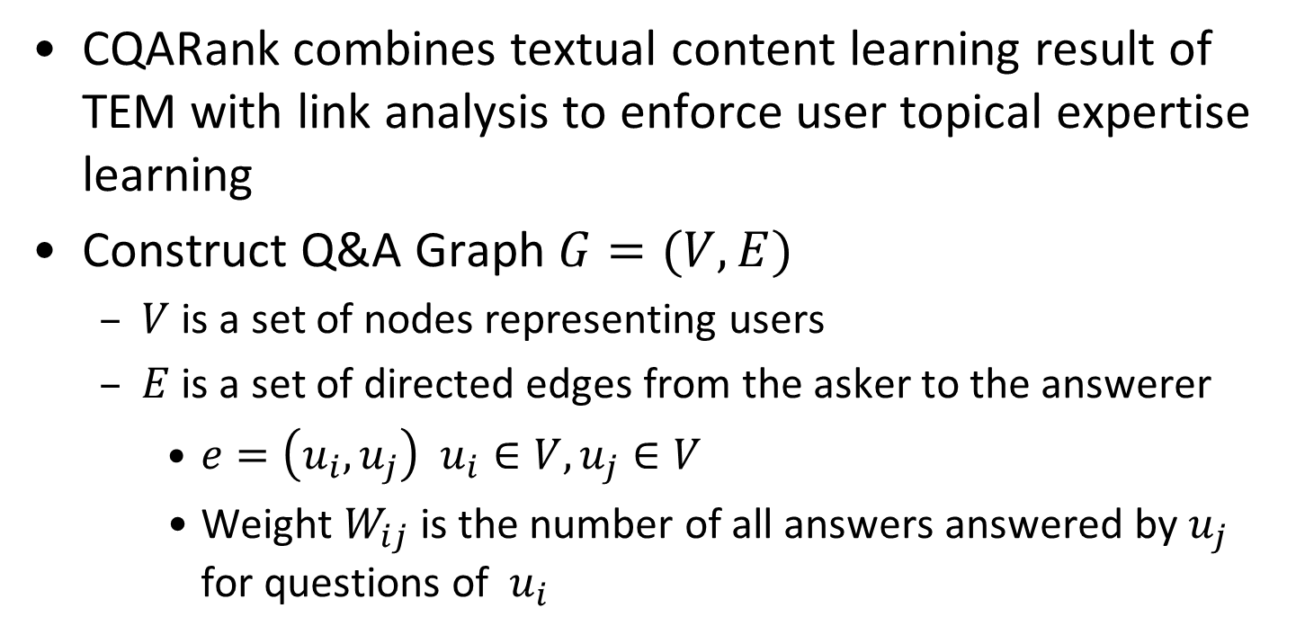
CQARank
CQARank combines textual content learning result of TEM with link analysis to enforce user topical expertise learning
Construct Q&A Graph $G=(V, E)$
$V$ is a set of nodes representing users
$E$ is a set of directed edges from the asker to the answerer
$e=\left(u_{i},u_{j}\right)$ $u_{i}∈V, u_{j}∈V$
Weight $W_{ij}$ is the number of all answers answered by $u_{j}$ for questions of $u_{i}$
CIKM2013
Notes:
TEM is a latent variable model for modelling textual contents and voting information to discover user topical interests and expertise. It does not make use of user network structure built from user Q&A graph. However, user network structure will be helpful for topical expertise learning because users who provide answers to high expertise
level users tend to also be with a high expertise. Inspired by this intuition, we propose $CQARank$ to combine user topical interests and expertise learning results in TEM with link structure analysis to enforce user topical expertise learning.
First of all, we construct a Q&A graph $G = (V,E)$in CQA. $V$ is a set of nodes representing all users. $E$ is a set of directed edges from the asker to the answer. The weight $W_{ij}$ is the number of all answers provided by $u_{j}$ for questions of $u_{i}$

Slide 15
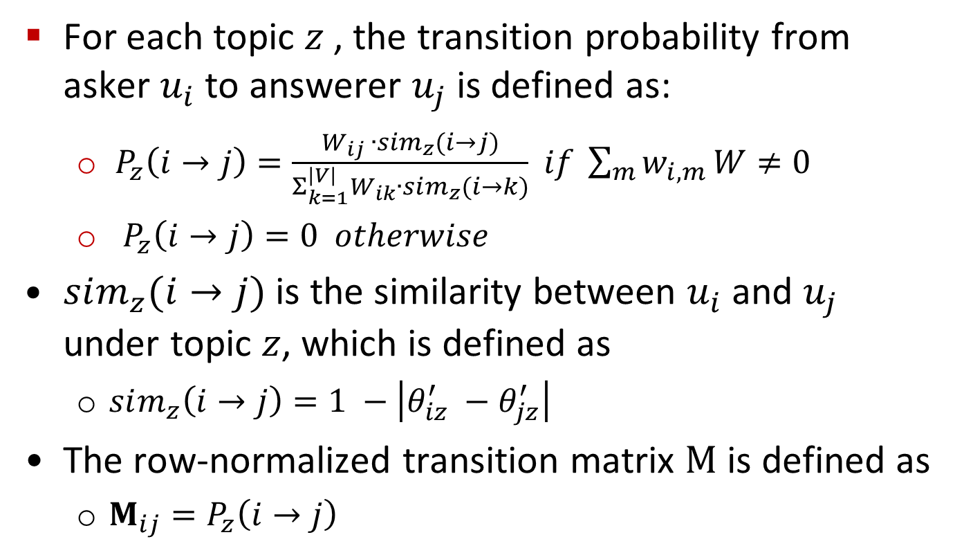
CQARank
For each topic $z$ , the transition probability from asker $u_{i}$ to answerer $u_{j}$ is defined as:
$P_{z}\left(i→j\right)=\frac{W_{ij} ∙sim_{z}(i→j)}{Σ_{k=1}^{\left|V\right|}W_{ik}∙sim_{z}(i→k)}$ $if \sum_{m}{w_{i,m}}W≠0$
$P_{z}\left(i→j\right)=0 otherwise$
$sim_{z}(i→j)$ is the similarity between $u_{i}$ and $u_{j}$ under topic $z$, which is defined as
$sim_{z}\left(i→j\right)=1 −\left|θ_{iz}^{′} −θ_{jz}^{′}\right|$
The row-normalized transition matrix $M$ is defined as
$M_{ij}=P_{z}\left(i→j\right)$
CIKM2013
Notes:
To let the random surfer visits user nodes with higher topical expertise and interest with larger probability, we incorporate the results from TEM into the transition matrix and teleportation vector computation of CQARank. Given a topic $z$, the transition probability of a random surfer from asker $u_{i}$ to answer $u_{j}$ is defined as follows:
$P_{z}\left(i→j\right)=\frac{W_{ij} ∙sim_{z}(i→j)}{Σ_{k=1}^{\left|V\right|}W_{ik}∙sim_{z}(i→k)}$ $if \sum_{m}{w_{i,m}}W≠0$
$P_{z}\left(i→j\right)=0 otherwise$
Here $sim_{z}(i→j)$ is the similarity between $u_{i}$ and $u_{j}$ under topic $z$, which is defined as
$sim_{z}\left(i→j\right)=1 −\left|θ_{iz}^{′} −θ_{jz}^{′}\right|$
$θ′$ is row-normalized matrix learnt as user specific topic distribution in TEM.
The row-normalized transition matrix $M$ is defined as
$M_{ij}=P_{z}\left(i→j\right)$
In this definition, the more $u_{j}$ answer questions of $u_{i}$ , the higher expertise $u_{j}$ will gain, which corresponds to a higher transition probability from $u_{i}$to $u_{j}$. Also $u_{j}$ is more likely to answer questions of $u_{i}$ if they share similar topical interests.

Slide 16
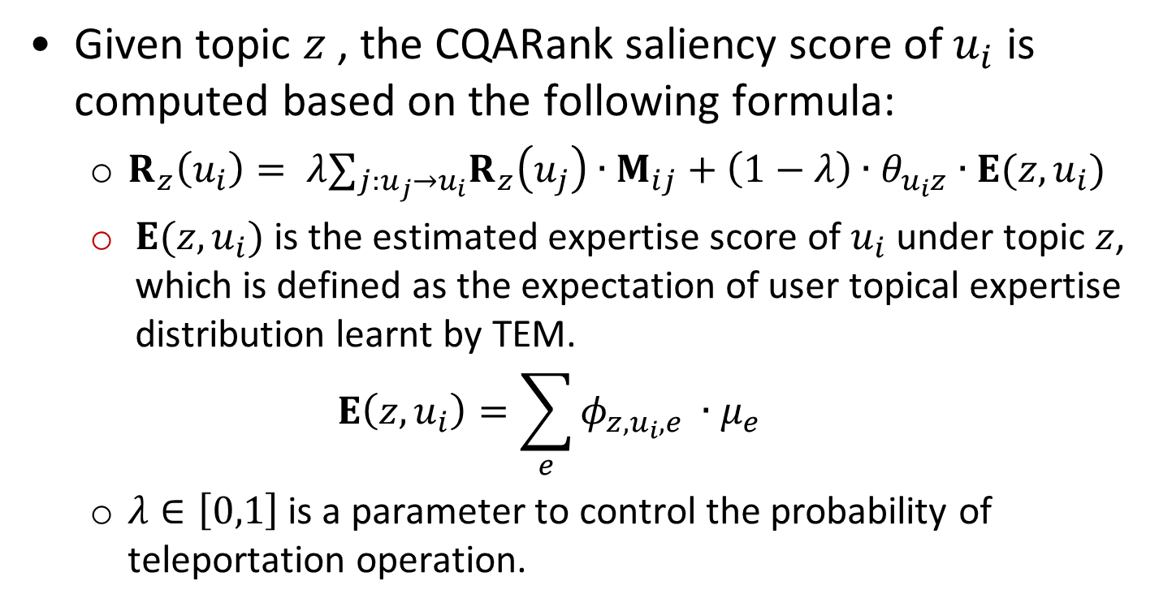
CQARank
Given topic $z$ , the CQARank saliency score of $u_{i}$ is computed based on the following formula:
$R_{z}\left(u_{i}\right)= λ∑_{j:u_{j}→u_{i}}R_{z}\left(u_{j}\right)∙M_{ij}+\left(1−λ\right)∙θ_{u_{i}z}∙E(z,u_{i})$
$E(z,u_{i})$is the estimated expertise score of $u_{i}$ under topic $z$, which is defined as the expectation of user topical expertise distribution learnt by TEM.
$$E\left(z,u_{i}\right)=\sum_{e}{φ_{z,u_{i},e} }∙μ_{e}$$
$λ∈\left[0,1\right]$ is a parameter to control the probability of teleportation operation.
CIKM2013
Notes:
Given topic $z$ , the $CQARank$ saliency score of $u_{i}$ is computed based on the following formula:
$R_{z}\left(u_{i}\right)= λ∑_{j:u_{j}→u_{i}}R_{z}\left(u_{j}\right)∙M_{ij}+\left(1−λ\right)∙θ_{u_{i}z}∙E(z,u_{i})$
$E(z,u_{i})$is the estimated expertise score of $u_{i}$ under topic $z$, which is defined as the expectation of user topical expertise distribution learnt by TEM.
$$E\left(z,u_{i}\right)=\sum_{e}{φ_{z,u_{i},e} }∙μ_{e}$$
$λ∈\left[0,1\right]$ is a parameter to control the probability of teleportation operation.
Thus $θ_{u_{i}z}∙E(z,u_{i})$ defines the teleportation vector of the random surfer under topic $z$ in $CQARank$
(Note that we can estimate each user’s topical expertise score by just using TEM results with $E\left(z,u_{i}\right)=\sum_{e}{φ_{z,u_{i},e} }∙μ_{e}$. However, for $CQARank$, we measure user topical expertise by the final saliency score $R_{z}\left(u_{i}\right)$when the iterated algorithm converges. The advantage of which is to combines results from TEM and link analysis of Q&A graph to further improve the user topical expertise discovery. We design recommendation experiments to compare performance of CQARank and TEM to reveal the effectiveness of incorporating Q&A graph information.)

Slide 17
Roadmap
Motivation
Related Work
Our Method
Method Overview
Topic Expertise Model
CQARank
Experiments
Summery
CIKM2013

Slide 18
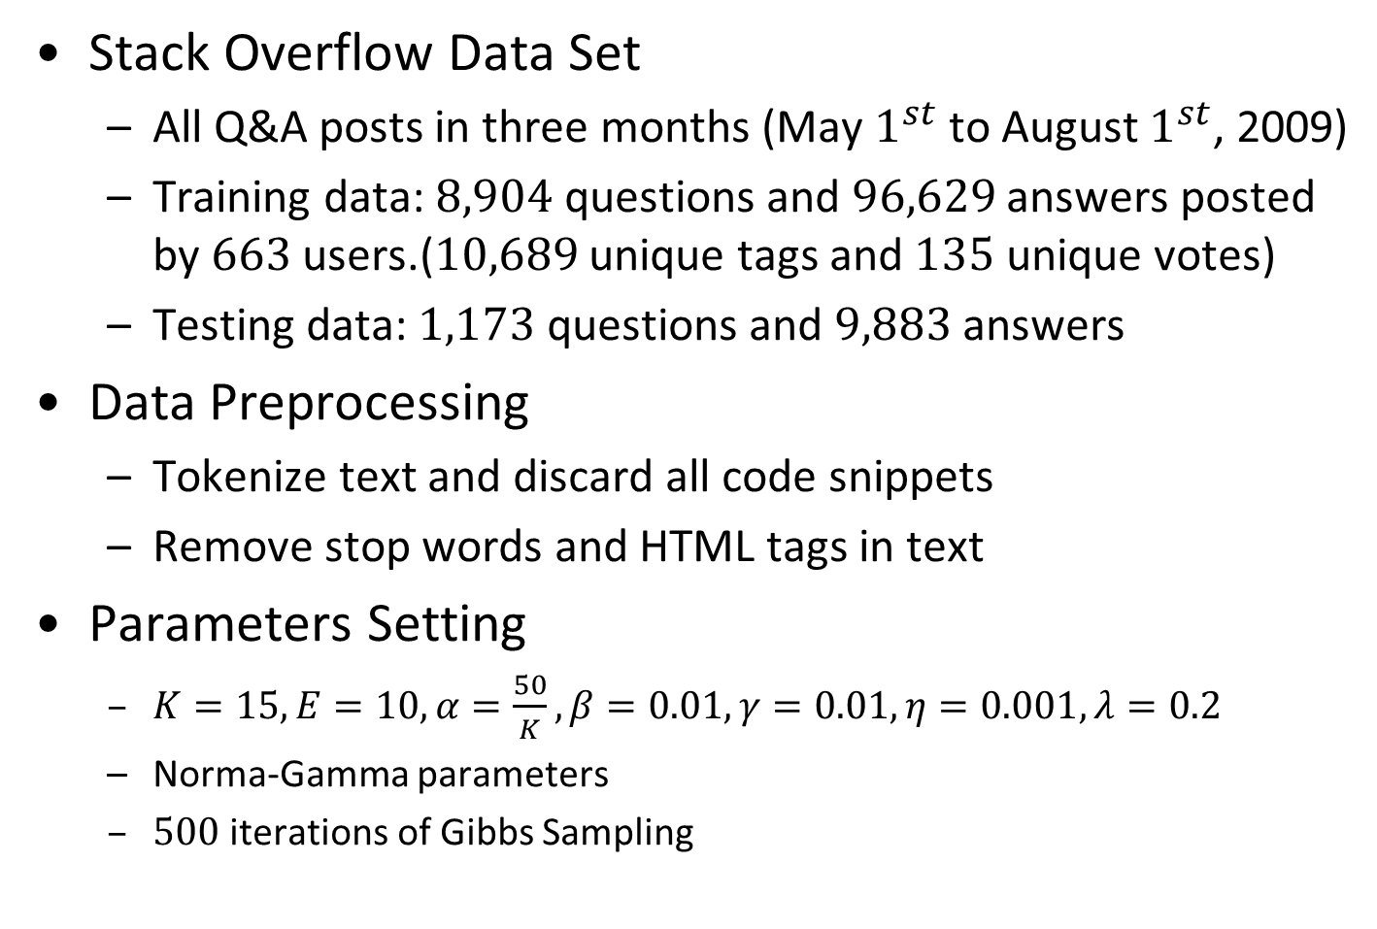
Experiments
Stack Overflow Data Set
All Q&A posts in three months (May $1^{st}$ to August $1^{st}$, 2009)
Training data: $8,904$ questions and $96,629$ answers posted by $663$ users.($10,689$ unique tags and $135$ unique votes)
Testing data: $1,173$ questions and $9,883$ answers
Data Preprocessing
Tokenize text and discard all code snippets
Remove stop words and HTML tags in text
Parameters Setting
$K=15,E=10, α=\frac{50}{K},β=0.01,γ=0.01,η=0.001, λ=0.2$
Norma-Gamma parameters
$500$ iterations of Gibbs Sampling
CIKM2013
Notes:
Now let’s look at our experiments. We use real data from Stack Overflow which is the most popular question answering community focusing on computer programming for experiments. We use all Q&A posts in three months from May 1st 2009 to August 1st 2009 and then use all the posts of users who have asked and answered no fewer than 80 times for the training of TEM.
So here is the statistics for our training data.
Our testing data for expert users and answers recommendation experiments is all posts of the same set of users in training data in a different time period. So training and testing data do not have any overlap. We also remove testing questions which have no, or only one, answer.
For data pre-processing, we tokenize text and discard all code snippets. Then we remove the stop words and HTML tags in text.
This is the parameter setting in our experiments.
(We run TEM with 500 iterations of Gibbs sampling. With some trails on the number of topics and expertise, we set topic number K = $15$, expertise number E = $10$ as they provide meaningful topics and vote Gaussian distributions for our data set. )

Slide 19
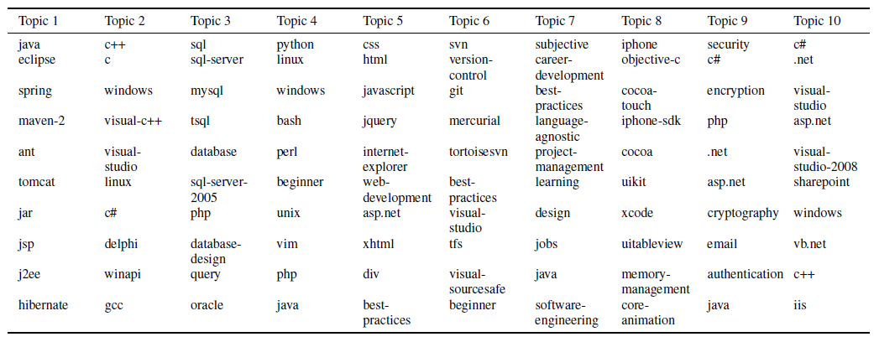
TEM Results
Topic Analysis - topic tags
Top tags provide phrase level features to distill richer topic information
CIKM2013
Notes:
For the experiment results, let’s firstly look at TEM model learning results. We illustrate top tags and words for 10 randomly selected topics discovered by TEM Here.
top tags like "career-development", "best-practices", "iphone-sdk", "memory-management", provide phrase level instead of bag of-words features to distill richer and better interpreted topic information from Q&A text.

Slide 20
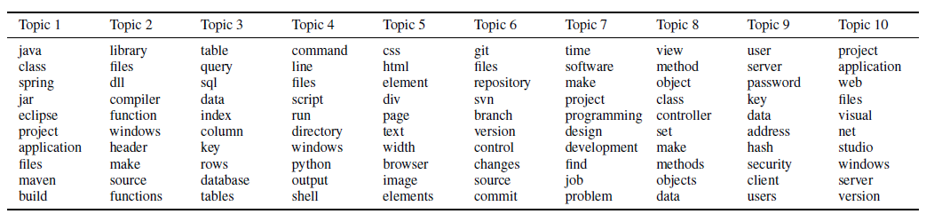
TEM Results
Topic Analysis - topic words
Top words have strong correlation with top tags under the same topic
CIKM2013
Notes:
We observe clean top words and tags for each topic. Top words have strong correlation with top tags under the same topic.

Slide 21
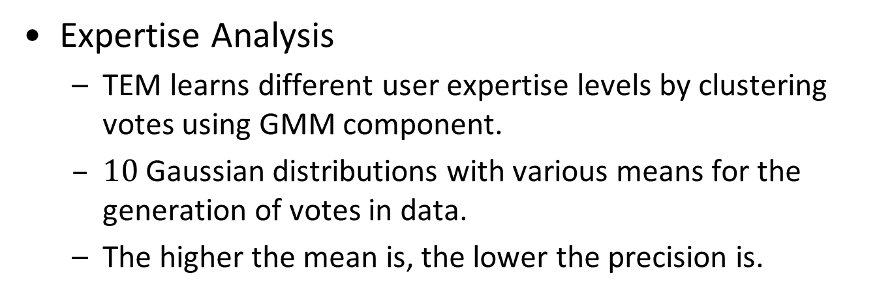
TEM Results
Expertise Analysis
TEM learns different user expertise levels by clustering votes using GMM component.
$10$ Gaussian distributions with various means for the generation of votes in data.
The higher the mean is, the lower the precision is.
CIKM2013
Notes:
Then we look at the expertise modelling part. TEM learns different user expertise levels by clustering votes using GMM component. The mean and precision
of different expertise specific vote Gaussian distributions learnt by TEM are shown in this table.
First, we observe 10 Gaussian distributions with various means ranging from $0.40$ to $40.17$ for the generation of votes in data. The mean of each Gaussian distribution can be used to denote expertise score for each expertise level.
Secondly, the higher the mean is, the lower the precision will be.

Slide 22
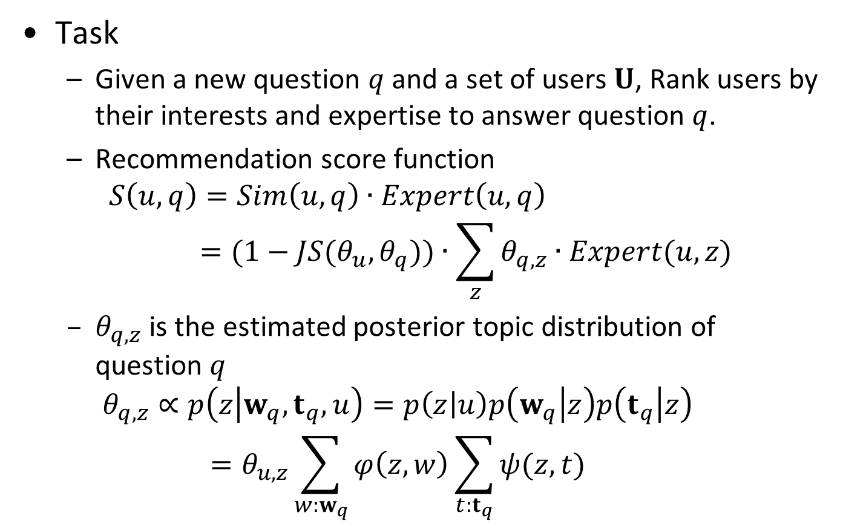
Recommend Expert Users
Task
Given a new question $q$ and a set of users $U$, Rank users by their interests and expertise to answer question $q$.
Recommendation score function
$$S\left(u,q\right)=Sim\left(u,q\right)∙Expert\left(u,q\right)=(1−JS(θ_{u},θ_{q}))∙\sum_{z}{θ_{q,z}∙Expert(u,z)}$$
$θ_{q,z}$ is the estimated posterior topic distribution of question $q$
$$θ_{q,z}∝p\left(z | w_{q},t_{q},u\right)=p\left(z | u\right)p\left(w_{q} | z\right)p\left(t_{q} | z\right)=θ_{u,z}\sum_{w:w_{q}}{φ\left(z,w\right)\sum_{t:t_{q}}{ψ(z,t)}}$$
CIKM2013
Notes:
For the quantitative evaluation of our proposed method, we design three recommendation experiments.
The first task we consider is to recommend expert users where our aim is to find users who can provide answers with high vote scores for a given question. Given a question $q$ and a set of test users $U$, the target is to rank all these users by their interests and expertise to answer the question $q$. We score each user $u$ by considering user topic similarity with the question $Sim(u, q)$and user expertise towards the question $Expert\left(u, q\right)$
The intuition here is that if the user is interested and have a high expertise for the question, then the user tends to provide a good answer wining high votes.
The recommendation score function is defined as follows:
$$S\left(u,q\right)=Sim\left(u,q\right)∙Expert\left(u,q\right)=(1−JS(θ_{u},θ_{q}))∙\sum_{z}{θ_{q,z}∙Expert(u,z)}$$
where $Expert(u, z)$ is the expertise of user $u$ under topic $z.$
$θ_{q}$ need to be estimated by computing its posterior probabilities: $θ_{q,z}∝p\left(z | w_{q},t_{q},u\right)=p\left(z | u\right)p\left(w_{q} | z\right)p\left(t_{q} | z\right)=θ_{u,z}\sum_{w:w_{q}}{φ\left(z,w\right)\sum_{t:t_{q}}{ψ(z,t)}}$
where $w$ and $t$ are the set of all the words and tags in question $q$. Here $θu,z$, $φ(z,w)$ and $ψ(z, t)$can be obtained from our TEM model results. After we score each user in $U$, we rank them in decreasing order of the score.

Slide 23
Recommend Expert Users
Our method
CQARank
Baselines
Link analysis method
In Degree(ID)
PageRank(PR)
Probabilistic generative model
TEM(Part of our method)
UQA( Guo et al. CIKM08)
Combine link analysis and topic model
Topic Sensitive PageRank(TSPR)(Zhou et al. CIKM12)
CIKM2013
Notes:
To evaluate the effectiveness of $CQARank$, we compare against some previous related works including link analysis techniques, probabilistic topic models and mixture methods combining both as follows.
Link analysis methods include InDegree(ID) and PageRank(PR). ID ranks users by the number of best answers provided by them. PR finds expert users with link structure analysis using standard PageRank algorithms.
Probabilistic generative model methods include TEM and UQA. TEM is our method without link analysis part. UQA is the User-Question-Answer Model for modelling
of Q&A text proposed by Guo et al. in CIKM 2008. The category in their model is similar to tags in TEM
The last baseline is the Topic-Sensitive PageRank method for expert finding in CQA proposed by Zhou et al. in CIKM 2012. They consider link structures and topical similarity between users.

Slide 24
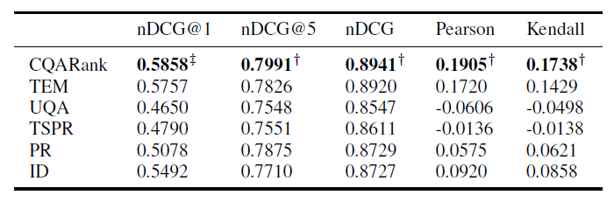
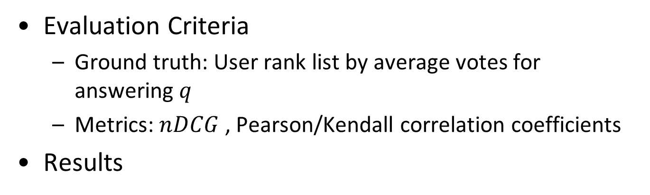
Recommend Expert Users
Evaluation Criteria
Ground truth: User rank list by average votes for answering $q$
Metrics: $nDCG$ , Pearson/Kendall correlation coefficients
Results
CIKM2013
Notes:
For the ground truth, we consider all the answerers for each question $q$ as the target user set $U$, and their averaged votes for each question are the ground truth vote scores. Then we generate a user rank list by average votes for answering $q$ as ground truth.
We use the commonly used $nDCG$ measure and Pearson/Kendall correlation coefficients to evaluate model results.
The results of expert user recommendation for new questions is shown in this table.
(1) $CQARank$and TEM perform well in the task. Especially looking at $nDCG,$ both methods achieve better performance than other methods.
(2) In terms of correlation based criteria, $CQARank$ can provide a user rank list with higher correlation coefficient with the ground truth rank list than all the other methods.
Overall, in this expert users recommendation task, our method significantly outperforms all baseline methods.

Slide 25
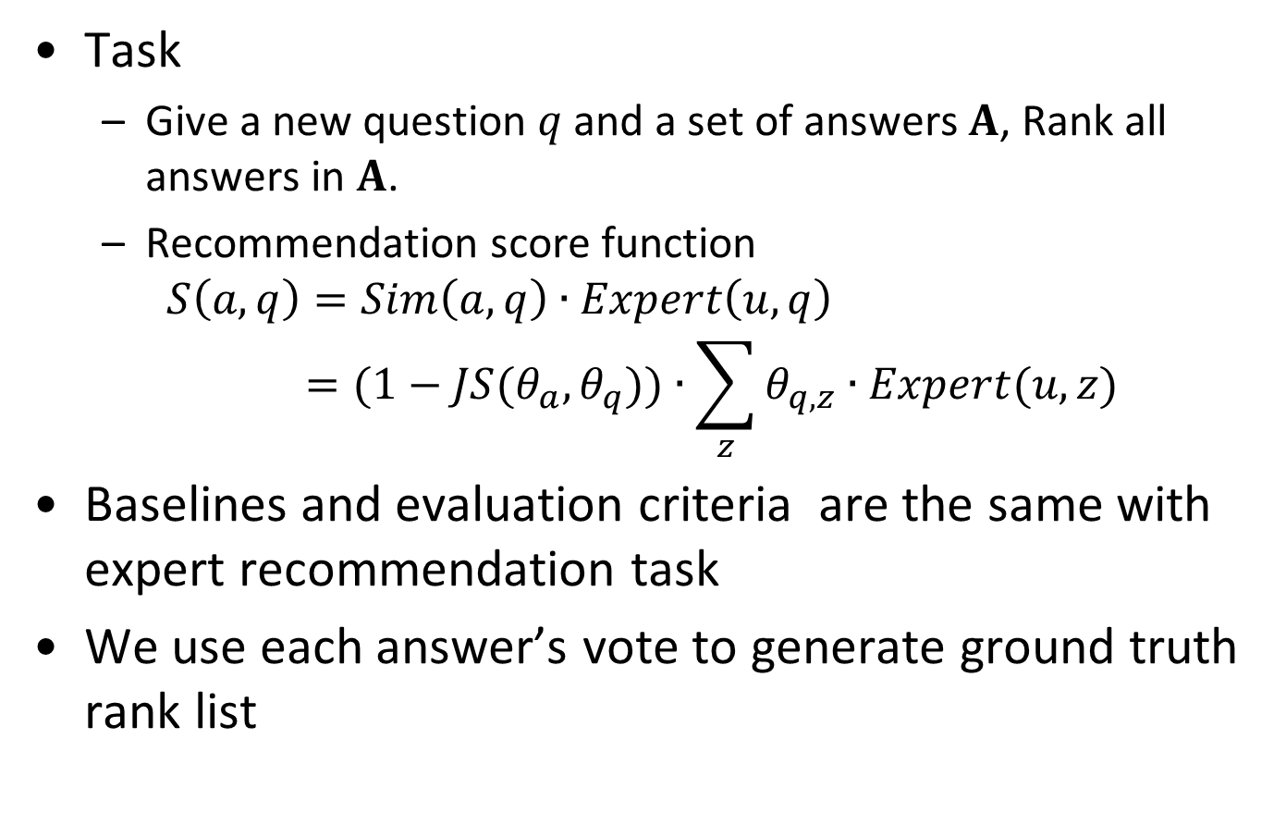
Recommend Answers
Task
Give a new question $q$ and a set of answers $A$, Rank all answers in $A$.
Recommendation score function
$$S\left(a,q\right)=Sim\left(a,q\right)∙Expert\left(u,q\right)=(1−JS(θ_{a},θ_{q}))∙\sum_{z}{θ_{q,z}∙Expert(u,z)}$$
Baselines and evaluation criteria are the same with expert recommendation task
We use each answer’s vote to generate ground truth rank list
CIKM2013
Notes:
The second task we consider is to recommend answers for a given question. Our task is defined as follows.
For a given question $q$ and a set of answers $A$, each method needs to rank all the answers in $A$. Similar to expert ranking task, we score each answer by considering its similarity to the question and the expertise of the answerer.
The baselines and evaluation criteria we consider for this task are the same with the expert recommendation task. Here we use each answer’s vote to generate ground truth rank list

Slide 26
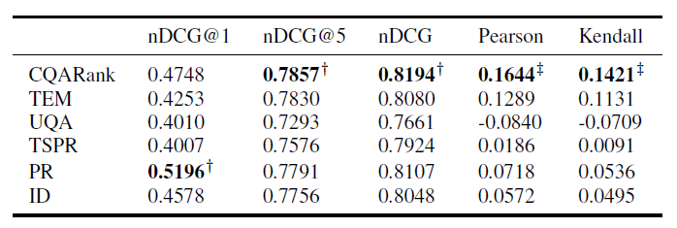
Recommend Answers
Result
CIKM2013
Notes:
This is the result for answer recommendation experiments. Again our CQARank shows the best performance. Although PageRank outperform our method for $NDCG@1$ score, our method performs better in terms of the overall $NDCG$ score. For the correlation efficiency, the result of our method is also better than baselines.
((1)CQARank and TEM show good results in the task, in terms of the correlation based criteria. CQARank provides an answer rank list with higher correlation coefficient with the ground truth rank list than all the comparing methods.
(2) CQARank significantly outperforms TSPR in terms of all criteria, at least 10% significance level by Wilcoxon signed rank test, which shows the advantage of considering vote
and tag information for user topical expertise discovery.
(3) We find in this task, to consider Q&A link structure is important as link analysis based approaches achieve better results than topic analysis based approach. Our method also shows clear advantage over TEM. )
Overall, in this task, CQARank outperforms all baseline methods.

Slide 27
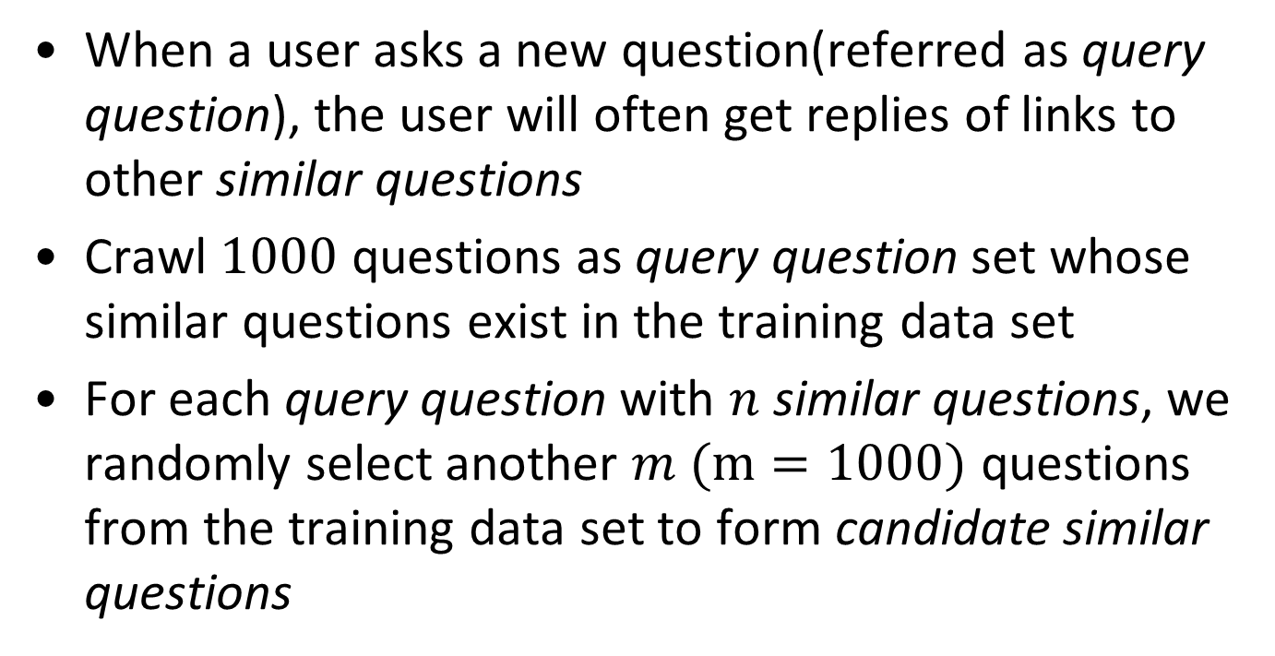
Recommend Similar Questions
When a user asks a new question(referred as query question), the user will often get replies of links to other similar questions
Crawl $1000$ questions as query question set whose similar questions exist in the training data set
For each query question with $n$ similar questions, we randomly select another $m (m=1000)$ questions from the training data set to form candidate similar questions
CIKM2013
Notes:
The third task we consider is to find similar questions for a given new question.
When a user asks a new question(referred as query question), the user will often get replies of links to other similar questions.
We crawl $1000$ questions as query question set whose similar questions exist in the training data set.
For each query question with $n$ similar questions, we randomly select another $m (m=1000)$ questions from the training data set to form candidate similar questions.

Slide 28
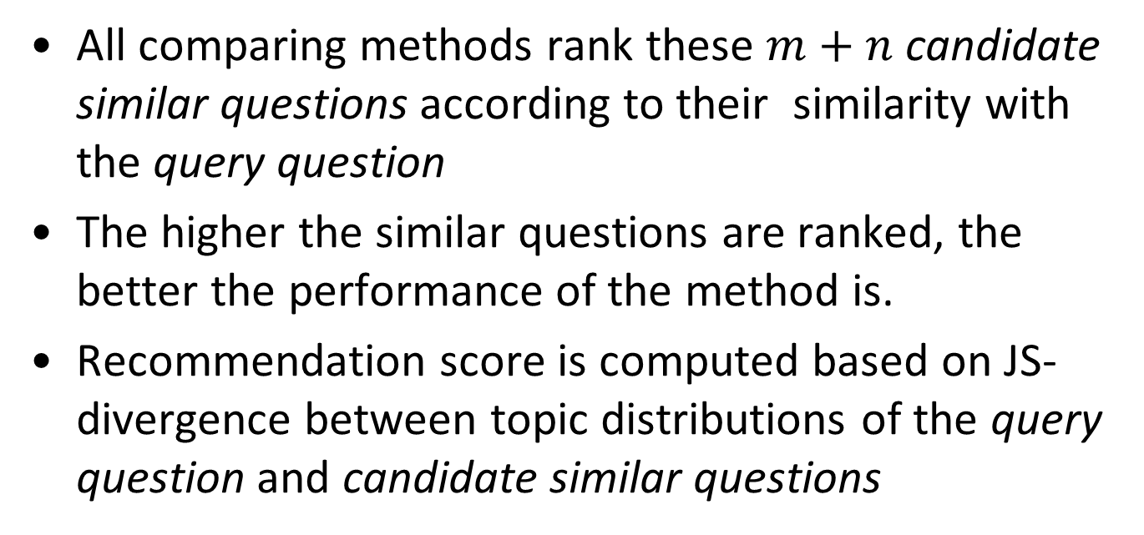
Recommend Similar Questions
All comparing methods rank these $m+n$ candidate similar questions according to their similarity with the query question
The higher the similar questions are ranked, the better the performance of the method is.
Recommendation score is computed based on JS-divergence between topic distributions of the query question and candidate similar questions
CIKM2013
Notes:
All comparing methods rank these $m+n$ candidate similar questions according to their similarity with the query question.
The higher the similar questions are ranked, the better the performance of the method is.
Recommendation score is computed based on JS-divergence between topic distributions of the query question and candidate similar questions.

Slide 29
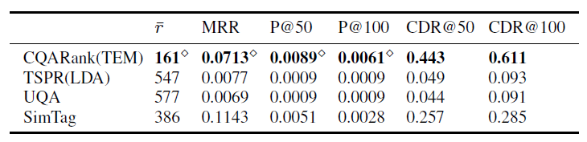
Recommend Similar Questions
Baseline
TSPR(LDA), UQA, SimTag
Evaluation Criteria
Precision@K, Average rank of similar questions, Mean reciprocal rank (MRR), Cumulative distribution of ranks (CDR)
CIKM2013
Notes:
Any topic analysis based approach can be used as baselines because the main task here is to find those questions topical similar with the query question. We consider TSPR and as our baselines. Note that topics learnt by TSPR are equivalent to compare with LDA, as TSPR uses LDA to learn topics by aggregating all posts of a user to form a “document”. To measure the usefulness of tags, we consider a simple baseline, SimTag, which recommends questions by looking at tag similarity. We use Jaccard Index to measure tag similarity, where the idea is the more tags two questions share the more similar they are.
We compare CQARank with baselines in terms of four criteria: precision, the average rank of the similar questions , mean reciprocal rank (MRR) and cumulative distribution of ranks (CDR).
We present the results in this table. CQARank shows a better performance than all baselines in terms of all measures.
This result indicates that our method significantly outperforms the comparing methods.
(We would like to stress that the task of recommending similar questions is difficult as the candidate question set is very large. Another challenge is that most of time, we only observe one similar question in our data set which is one question that appears as a link in the post replying to the query question. In this case, the task is essentially
to rank this question among more than 1000 candidate question set. It is therefore not surprising to observe that the precision of all the methods are not high. Yet, our method shows much better precision among all.
Furthermore, all the comparing methods show a low CDR score. In CDR@50, less than 5% of query questions are observed with similar questions being ranked at least in top-50 position. Our method performs significantly better, with more than 40% of query questions.
Moreover, the results show the effectiveness of considering tags to measure topics as the SimTag baseline has a better performance than TSPR and UQA.
Our method outperforms all the baselines mainly because of two factors: (1) using tags to help learn topics; (2) jointly models topics and expertise, where the interplay between them can affect the formation of topics.)

Slide 30
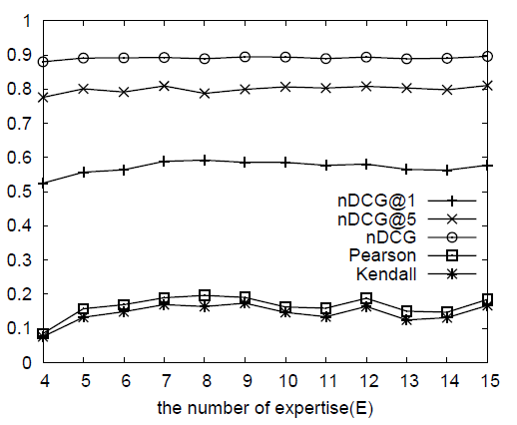
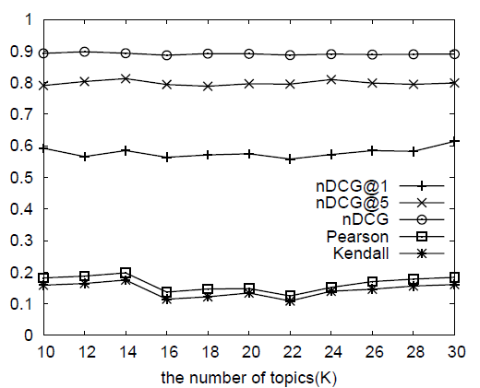
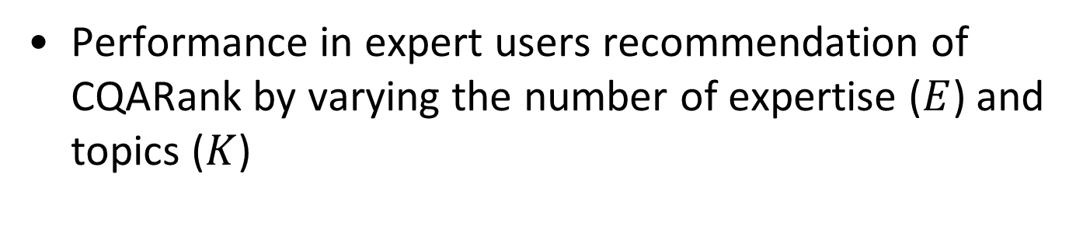
Parameter Sensitivity Analysis
Performance in expert users recommendation of CQARank by varying the number of expertise ($E$) and topics ($K$)
CIKM2013
Notes:
We further give parameter sensitivity analysis for our proposed CQARank and Topic Expertise Model. CQARank is based on the topics and expertise model results of TEM, hence the choice of parameters settings such as topic number, K and expertise number, E in TEM will also influence the performance of CQARank.
We can see that CQARank has stable performance with varying setting of parameters.

Slide 31
Roadmap
Motivation
Related Work
Our Method
Method Overview
Topic Expertise Model
CQARank
Experiments
Summery
CIKM2013

Slide 32
Summery
Conclusions
A probabilistic generative model to jointly model topics and expertise in CQA services
CQARank algorithm to combine textual content learning with link analysis
Our model is generalized and applicable for various CQA tasks
Future Work
Temporal analysis of topic expertise and interests in CQA
Social influence of experts
CIKM2013
Notes:
In conclusion, in this paper we proposed Topic Expertise Model to jointly model topics and expertise in CQA services.
Based on its model results we proposed CQARank to combine textual content learning with link analysis for deriving the user expertise and interests score under various topics.
Our model is generalized and applicable for various CQA tasks including expert finding, relevant answers retrieval, and similar questions recommendation.
Our extensive experimental studies on Stack Overflow data sets demonstrates the effectiveness of our model when compared to other existing methods.
In the future we expect to further study the temporal aspect of users in CQA. In real world, the interests and expertise of users change with time. Capturing such temporal information could be more beneficial in recommendation tasks of CQA.
Another interesting aspect is the social influence of users on CQA. The answerer profile might influence the voting behaviour of users and hence impacts the recommendation methods.
It is an interesting problem to analyse the components in CQA for adaptive recommendation systems.

Slide 33
Thank you
Q&A
Notes:
Thank you for your time!
Thanks!

